Slide 1
Plume Height Measurements using MISR Satellite Observations and MINX
Nolan Dickson, Chris McLinden, Mark Shephard, Jack Chen, Ahmed Lezzaik, Jesse Thompson, + …

Slide 2
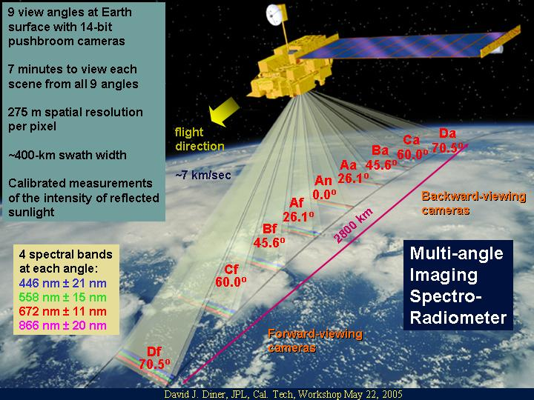
MISR
Orbiting aboard the NASA Terra satellite, in a sun-synchronous polar orbit, with a local overpass time of 10:30am.
The Multi-angle Imaging SpectroRadiometer (MISR) contains nine cameras, which face earth at different angles.
Smoke Plume Heights ~500 m vertical accuracy at a 1.1 km horizontal resolution
We utilize the nine imagery files from the MISR cameras, as well as camera geometry and aerosol data, along with some ancillary data, to calculate smoke plume heights.
Notes:
MISR, short for The Multi-angle Imaging SpectroRadiometer, flies aboard the NASA EOS satellite, Terra. The Terra satellite orbits the earth in a near-polar, sun-synchronous orbit, with a local overpass time of about 10:30am. The MISR instrument contains nine different cameras which, as can be seen in the figure, image earth at nine different angles, ranging from 70.5 degrees above nadir, to 70.5 degrees below. The cameras photograph the same position on earth, in the blue, green, red and near-infrared bands, with about a 7 minute difference from the forward-most camera (Df) to the rear-most (Da). The camera’s capture about at 400-km wide swath with a spatial resolution of 275 metres per pixel.
This multi-angle imaging allows for the stereoscopic retrieval of smoke plumes, by observing the changes in the plume between each image. To facilitate this, we utilize the nine camera images, as well as camera geometry and aerosol files, to calculate plume heights.

Slide 3
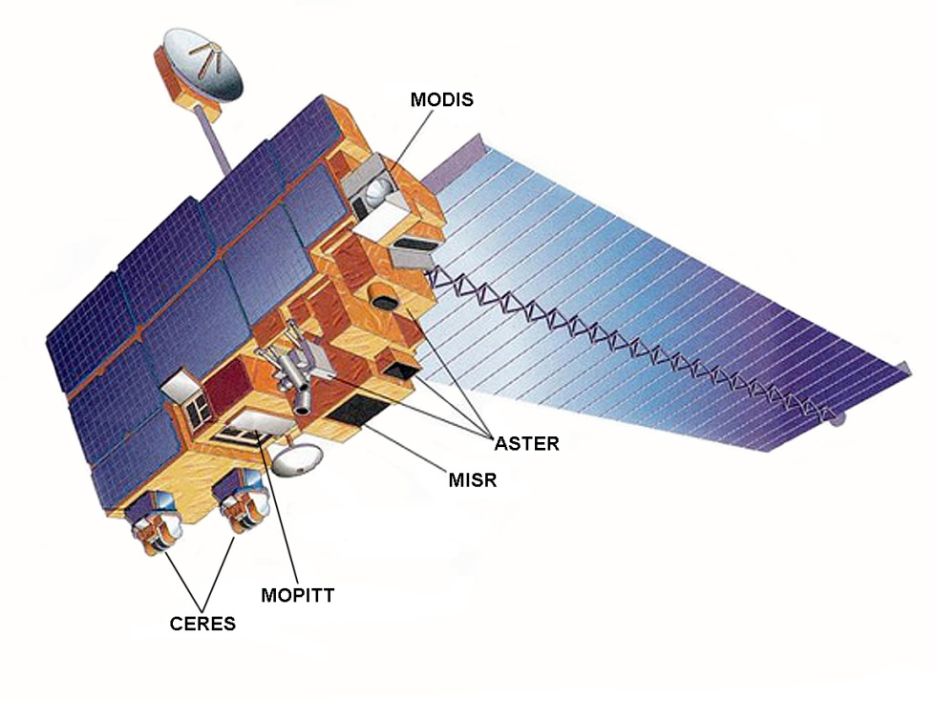
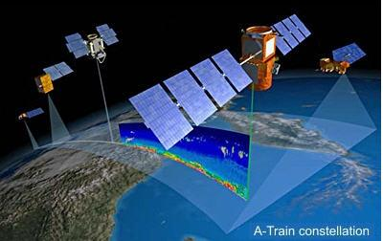
Other relevant instruments
Also flying aboard Terra is the Moderate Resolution Imaging Spectroradiometer (MODIS)
Views the earth through a single instrument with a 2330 km wide swath (MISR is centered on this)
IR band data is utilized to find thermal anomalies, which could constitute a fire
For comparison, will also examine the output of the CALIOP LIDAR instrument, flying aboard the Calipso satellite
Provides high-resolution vertical profiles of aerosols and clouds, but with sparse coverage (“pencil beam”)
Notes:
The second instrument which is used in the process of plume height calculation is MODIS. The Moderate Resolution Imaging Spectroradiometer flies aboard the Terra satellite, alongside MISR. It views the earth below with a 2330 km wide swath, in 36 different bands. MODIS and MISR both share the same center of their swaths.
Relevant to us, the infrared band data is utilized to find thermal anomalies. These “fire pixels” are used to find plumes to digitize.
We’ll also look at the CALIOP LIDAR instrument today, in order to check the heights we receive from MISR. Flying aboard the Calipso satellite, CALIOP provides a high resolution vertical profile of the space directly below it. Unfortunately it has very sparse coverage, and it is rare for the instrument to actually profile a specific fire plume.

Slide 4
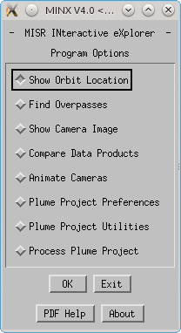
MINX
MISR INteractive eXplorer (MINX) is a visualization and analysis tool providing the ability to retrieve local heights for smoke, dust and ash plumes.
Takes advantage of wind-direction information inherent in smoke plumes to determine plume heights
Notes:
On to the digitization software: MINX, short for the MISR interactive explorer, is a visualization and analysis tool which was created by NASA JPL to provide users with the ability to retrieve local wind-speeds and heights for smoke, dust and volcanic ash plumes.
The software takes advantage of wind-direction information inherent in smoke plumes to calculate plume heights with a greater resolution and accuracy than provided by the standard operational MISR product.

Slide 5
Process
MODIS thermal anomalies give the location of “fire pixels”
MINX selects certain fire pixels based on user-given parameters, and determines the corresponding MISR images needed.
Users enclose the plumes in a polygon manually, and MINX calculates plume heights and wind speeds.
The process has been semi-automated:
“procMODIS” tool will gather necessary data and process fire pixels, users must still draw polygons.
Notes:
The process that MINX uses is quite simple, overall. The MODIS instrument provides Thermal anomaly data, known as “Fire Pixels”.
MINX selects certain fire pixels based on parameters and settings given by the user, such as the minimum fire radiative power, and from this determines which MISR images and data it requires to examine the plumes caused by these pixels.
Once the user has these images, they must manually enclose the plumes they desire, by looking at the MISR images. MINX will then use this data to determine the plume’s height and local wind speeds.
This process has been mostly automated. The downloading of all necessary MODIS and MISR data, as well as preprocessing of the MODIS Fire Pixels, can now be handled by the procMODIS tool. This tool simply takes the date and coordinate range you desire, and sets everything up for you to be able to digitize the plumes. Users must still, however, manually draw the polygon to surround the plumes they desire.

Slide 6
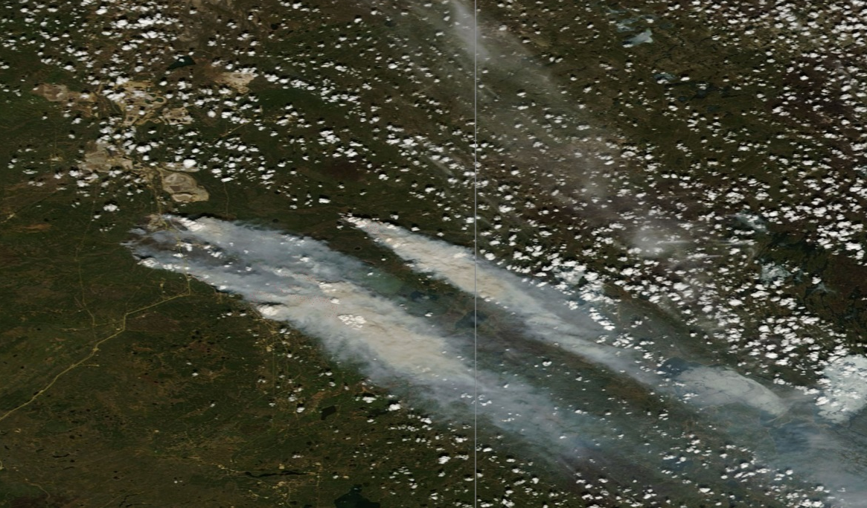
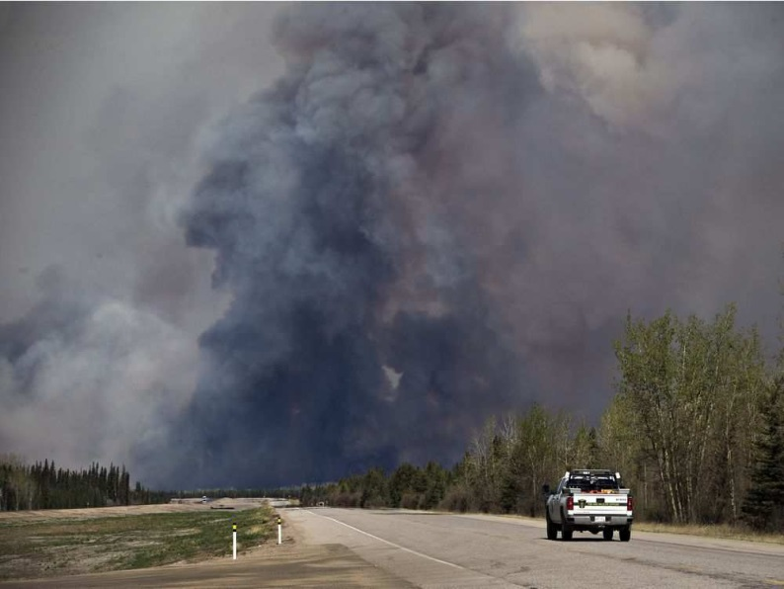
Fort McMurray Wildfire (May 6th) Example
Terra satellite passed over Fort MacMurray on May 6th, 2016 at 18:34 UTC
-THE CANADIAN PRESS
-MODIS True Reflectance Image
Notes:
The first example we’ll look at covers the Fort MacMurray wildfire on May 6th, 2016. The Terra satellite made an overpass of the fire at around 18:34 UTC. On the right you can see the image taken by MODIS as it passed overhead, showing the city and the large plumes to the southeast. We’ll focus on the uppermost plume from that image.

Slide 7
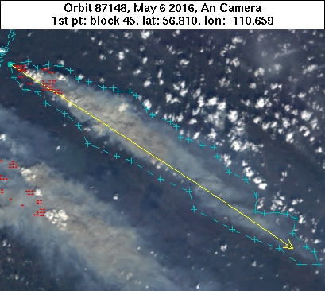
Fort McMurray Wildfire (May 6th) Example
Using the MODIS fire pixels, and the MISR visual images, users identify the plume to be digitized.
Users manually draw a polygon surrounding the plume, beginning at the fire source
Users approximate the wind direction by regarding the apparent direction of plume travel.
Notes:
Using the MODIS Fire pixels, seen here as red dots, and the nine MISR visual images, users must identify the plume the wish to digitize and draw a polygon to surround it, by clicking on the boundaries of the smoke, beginning at the source of the fire. This is the light-blue border you see.
Users must also then approximate the wind direction near the plume, by observing the apparent direction the plume is traveling. This is shown as the yellow arrow.

Slide 8
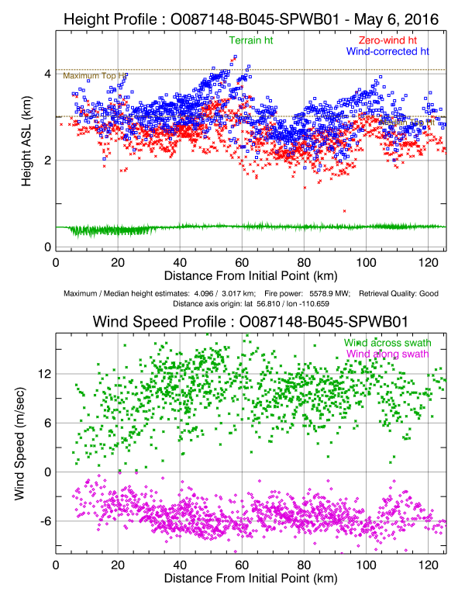
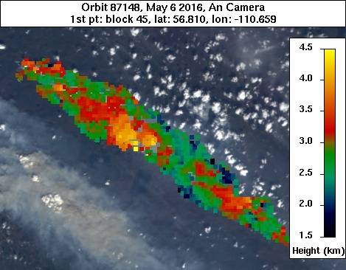
Fort McMurray Wildfire (May 6th) Example
MINX outputs plume height and wind speed results
Notes:
From this inputted data, MINX will output plume height and wind speed results.
On the top right we can see the height profile of the plume. This particular plume has a maximum height of 4.096 km and a median height of about 3.017 km.
In red we have the “zero-wind” heights, which are fictitious heights that assume no wind disparity. The actual calculated heights we see in blue. The terrain heights are shown in green at the bottom of the plot, which is plotted based on distances from the source point.
In the bottom right we have the wind speed profile. This shows the calculated wind speeds inside the plume, with green demonstrating the wind moving horizontally along the swath, and pink vertically. The positive direction for these speeds is taken as the North-East.
Finally we have the image of the plume. This is the same image seen in the last slide, but with the plume heights overlaid. All heights are calculated from sea level.

Slide 9
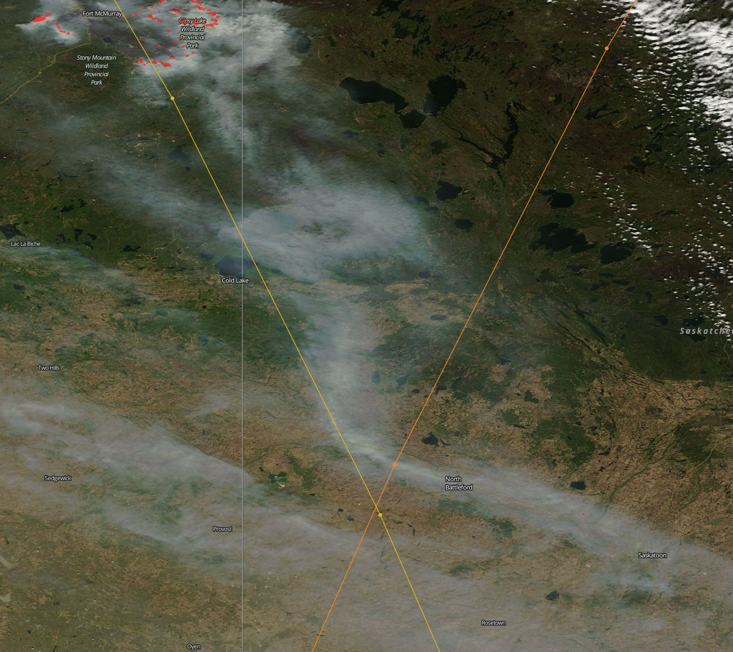
Fort McMurray Wildfire (May 15th) Example
Terra satellite passed south of Fort MacMurray on May 15th, 2016 at 18:28 UTC
Missed main plume, but coincided with Calipso overpass
CALIOP overpass
MISR overpass
Notes:
The second example also covers the Fort MacMurray wildfire, this time for the 15th of May, 2016. The MISR overpass on this date was slightly too southern to capture the entirety of the fire, but it does intersect well with an overpass from the Calipso satellite. While MISR has a imagery swath extending approximately 200 metres on either side of its orbit, shown in orange, CALIOP only captures directly under its orbit, shown in yellow.

Slide 10
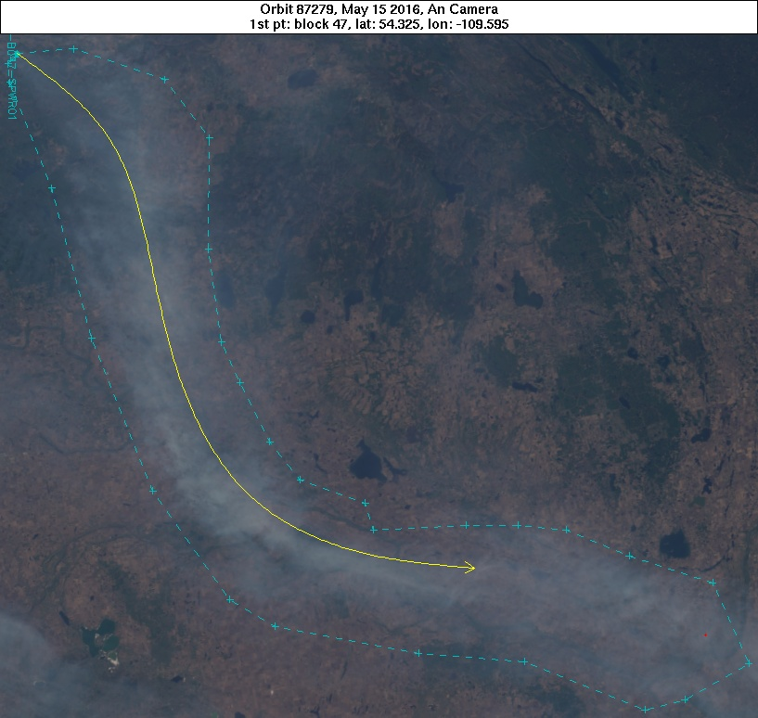
Fort McMurray Wildfire (May 15th) Example
Lingering plume chosen as it is also covered by Calipso LIDAR.
CALIOP overpass
Notes:
We will look at the lingering plume which is contained in the MISR swath and is passed over by Calipso.
Once again, the user draws a polygon surrounding the plume in question, and indicates the apparent wind direction. As can be seen here, the wind direction does not have to be linear.

Slide 11
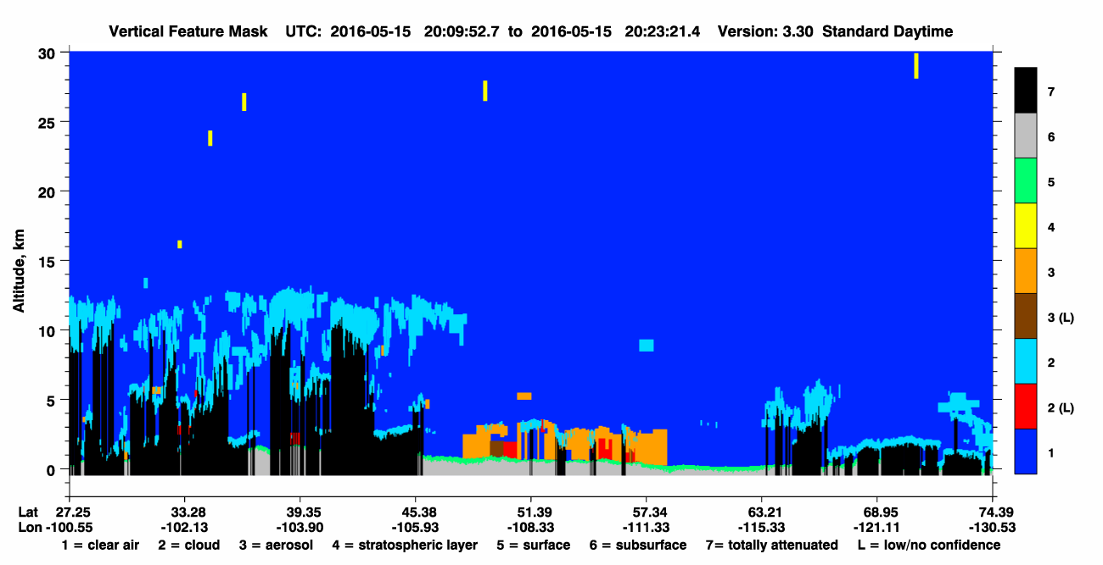
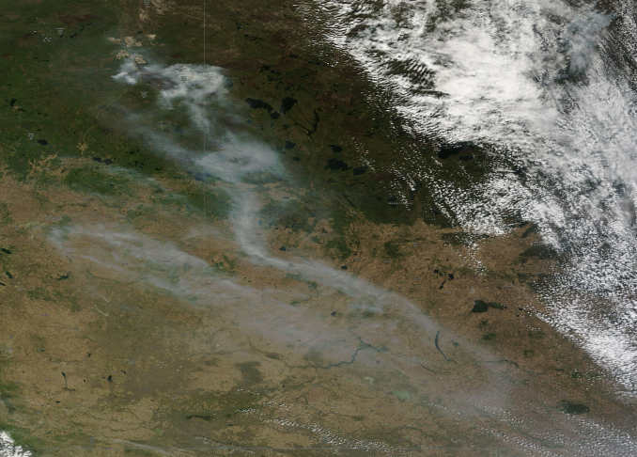
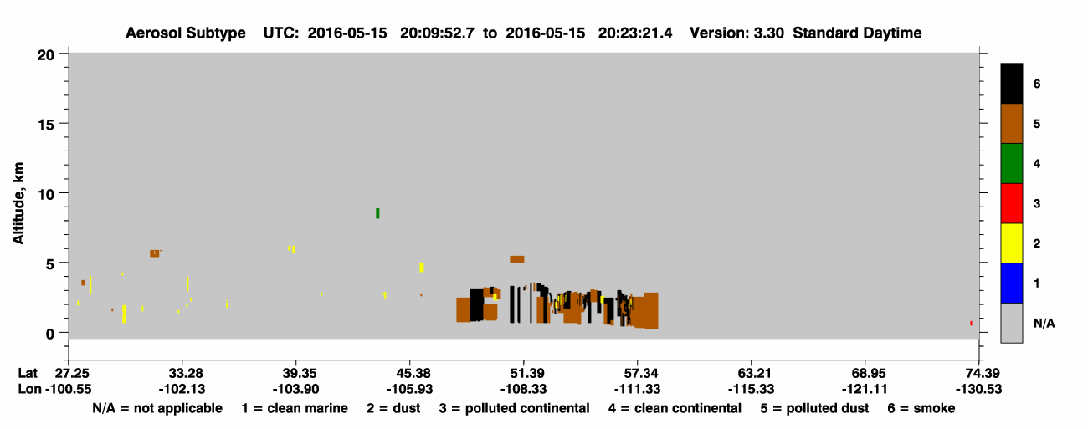
Fort McMurray Wildfire (May 15th) Example
Calipso vertical feature masks.
Height of plume ~3 km
Fort McMurray _{x}
Terra MODIS
True Color Composite 15th May 2016
Notes:
Here we see the results of the Calipso CALIOP overpass. From these two plots, we can see the area of the overpass which contains the smoke plume. The height of the aerosol in this area is approximately two to three kilometres above sea level.

Slide 12
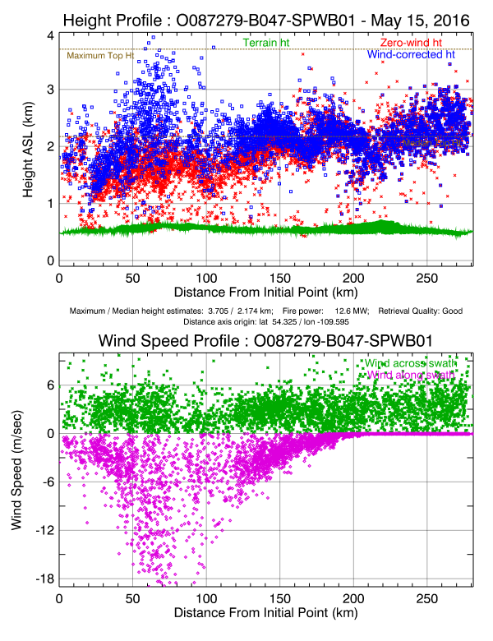
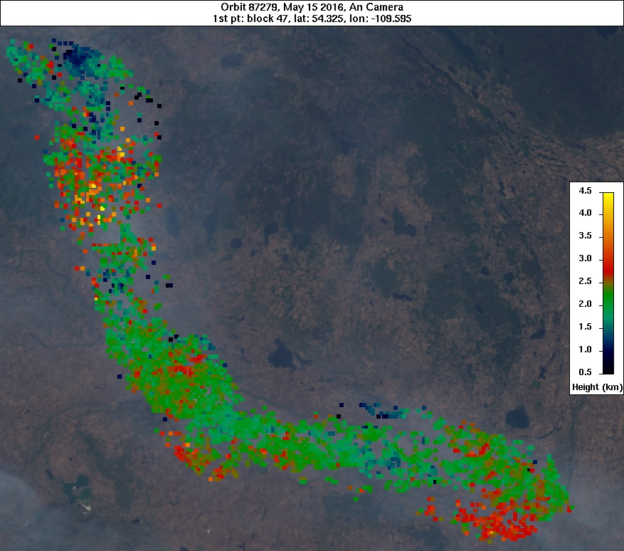
Fort McMurray Wildfire (May 15th) Example
MINX outputs plume height and wind speed results
Notes:
Here we see the results of the MISR plume height calculations. As before, rightmost graphs showcase the height and wind speed of the plume. The median height of this plume is approximately 2.2 kilometres above sea level.

Slide 13
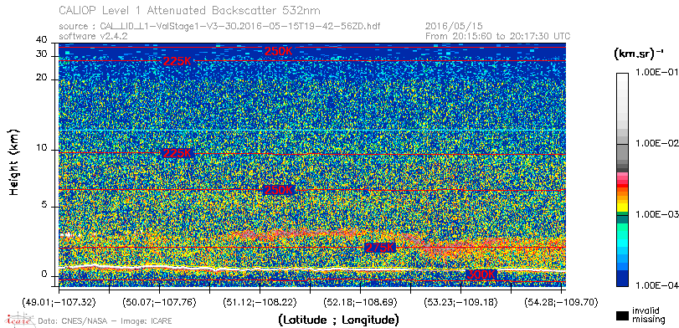
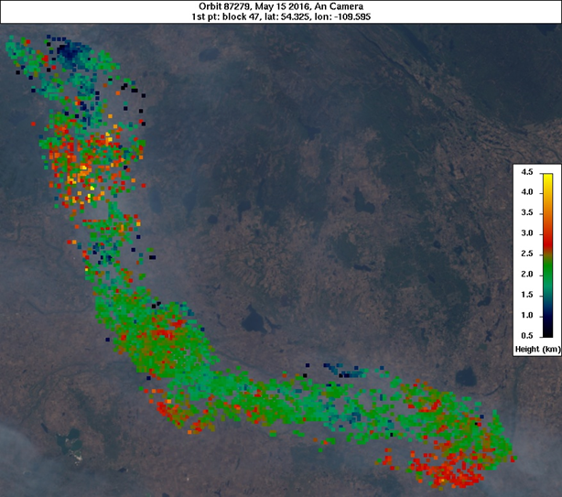

Fort McMurray Wildfire (May 15th) Example
Comparison with Calipso LIDAR attenuated backscatter
2.5 km
2.5 km
MISR and Calipso provide comparable smoke plume heights of ~2.5 km for the part of the smoke plume seen by both instruments. Note that Calipso is about 3 hours later than MISR.
Notes:
Comparing the two results, here we see the level-1 attenuated backscatter from CALIOP alongside the plume heights calculated by MINX. The red areas roughly correspond to one another, indicating the area, shown in the left image, where Calipso intersects the plume.
The median value from the MISR data, enclosed in this square, is only slightly higher than the 2.2 kilometres of the entire plume, as stated earlier.
Closely observing the CALIOP data, we can see that the extinction increase, shown in red and indicating the presence of some aerosol, occurs within the square between 2 and 3 kilometres above sea level.
The MISR data is very slightly lower than that of CALIOP, but this may also be attributable to the overpass times of the two satellites, with Calipso orbiting over the area an hour later than Terra.

Slide 14
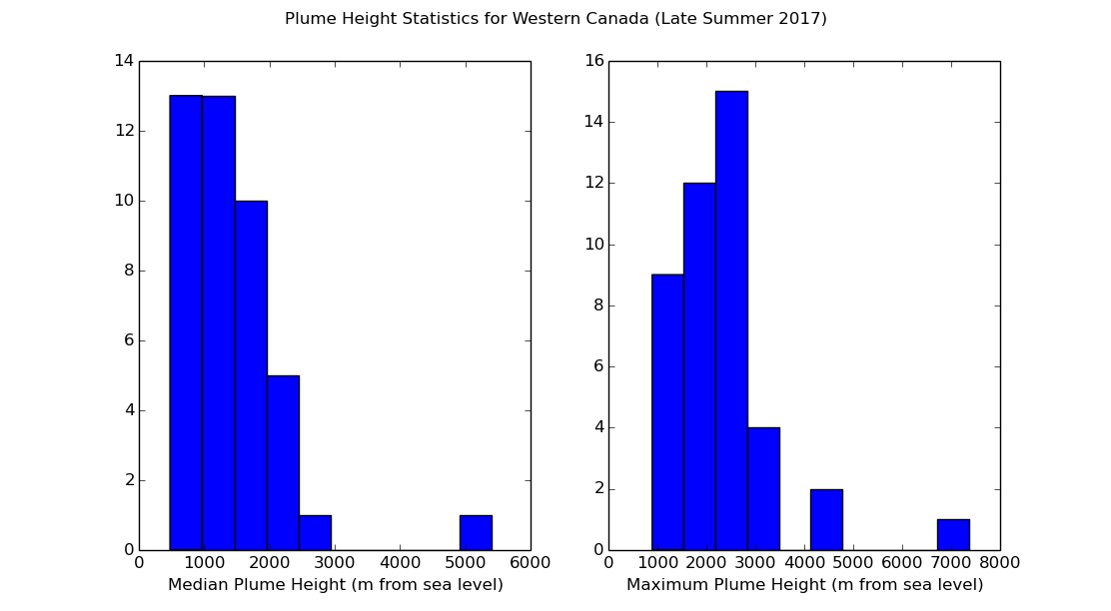
Summary
Plumes in western Canada from August to October of 2017 had, on average, a median height of ~1 km and a max height of ~2.5 km
Outlier on right is due to cloud cover
Notes:
Recently upwards of 85 plumes in western Canada, that is Manitoba, Saskatchewan and Alberta, were digitized using MINX.
These are just a few quick graphics of their results. On the left is the median smoke height for each plume, where we can see that on average, the median height landed at around 1 kilometre from sea level.
On the right we have the maximum smoke height for each plume, where the average now falls around 2.5 kilometres high.
The outlier on both graphs actually results from a small fire in Manitoba, which had a stray cloud near the end of it’s plume.

Slide 15
Summary
Pros
Plume heights derived from the MIRS observations within the MINX processing look very promising.
~ 400 km wide swath provides relatively high degree of spatial coverage
40 times more likely to observe a plume than Calipso
Polar sun-synchronous Terra orbit provides consistent observations
Over 25, 000 plumes have already been digitized in the NASA MISR Plume Height Project (but only older plumes)
Cons
Ability to digitize plumes relies heavily on clear images (no cloud cover, within MISR swath, etc.)
MISR plume heights are at the overpass time of ~10:30am
Does not cover the full diurnal nature of fire plumes
often reach peak heights in afternoon.
Each plume must be manually digitized (but pre-processing is automated)
Notes:
Overall, we have just a few pros and cons of utilizing MISR to determine plume heights.
The MISR instrument has a relatively large swath, covering over 400 km horizontally. This allows it to provide a large degree of spatial coverage. Some have calculated MISR to be 40 times more likely to observe a plume than CALIOP.
The near-polar, sun-synchronous orbit of MISR’s satellite, Terra, provides consistency in the timing and lighting of the MISR images.
Over 25 000 historical plumes have already been digitized through a NASA project, and their results are all easily accessible online. Therefore, any plumes you wish to investigate before 2011 are most likely already available.
On the downside, MISR’s ability to distinguish plumes relies heavily on clear images. This means that anytime clouds cover the fire, or the plume does not lie clearly within 400 kilometres of the orbit, the plume cannot be digitized.
Also, the relatively early daytime overpass of approximately 10:30 am means that MISR misses the period of the day where fire plumes reach their maximum heights. Therefore MISR only generally covers younger, lower plumes, and may not showcase the maximum height the plume could possibly reach that day.
As well, each plume, if not included in the NASA project above, must be manually digitized. Although the pre-processing of these plumes is now automated, and users must only circle the plumes by hand.

Slide 16
Potential Future Applications
Model evaluation of fire plume heights
Working closely with Jack
Improve satellite-based fire emission estimates of ammonia, nitrogen dioxide
Rely on a estimate of the plume height and winds
Provide additional information on aerosol optical properties from forest fires based on other output MISR products
Notes:
Finally, this process will be used in the future for different reasons, including:
The evaluation of plume heights given by models,
Satellite based emission estimates of ammonia, nitrogen dioxide, and etc, and
The use of other MISR data, including aerosol optical properties from forest fires.

